Slide 1
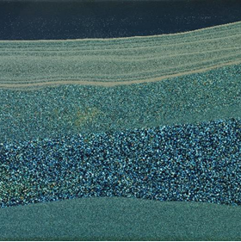
Institute for Modelling Hydraulic and Environmental Systems
Department of Hydromechanics and Modelling of Hydrosystems
FluidFlower Benchmark:
Participants Update
Bernd Flemisch
16.02.2022

Slide 2
Reported Results Dense Data Time Series
All measurables identified in section 2.7 shall be reported at 10-minute intervals starting at the initial injection and lasting 120 hours. The data is expected in csv format in a file time_series.csv of the form
# t, p_1, …, totalCO2Mass 0.000e+00, 1.234e+56, 1.234e+56, <…> 6.000e+02, 1.234e+56, 1.234e+56, <…> ...
according to the measurables defined in section 2.7.

Slide 3
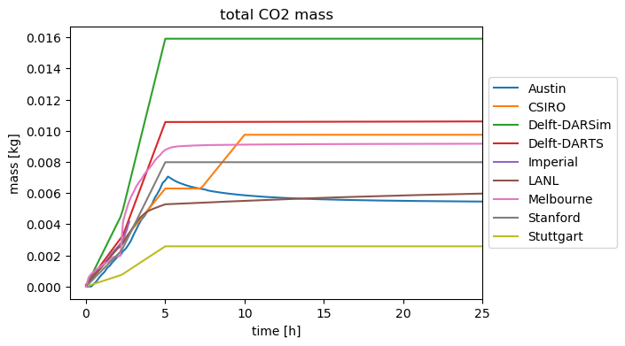
Time Series: Total CO2 Mass

Slide 4
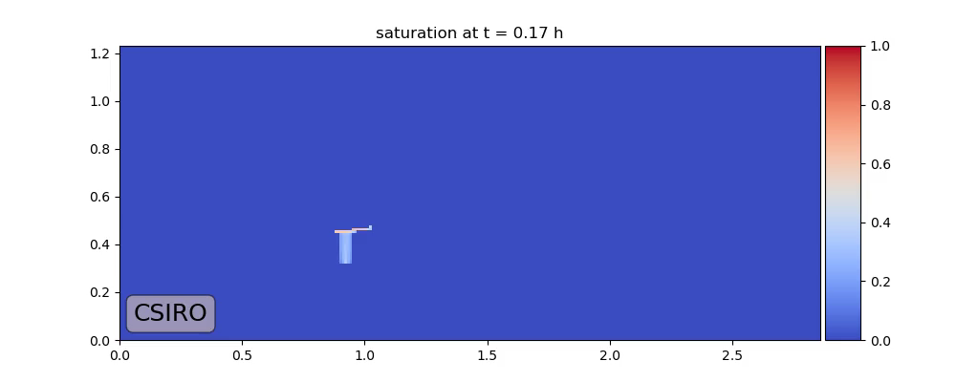
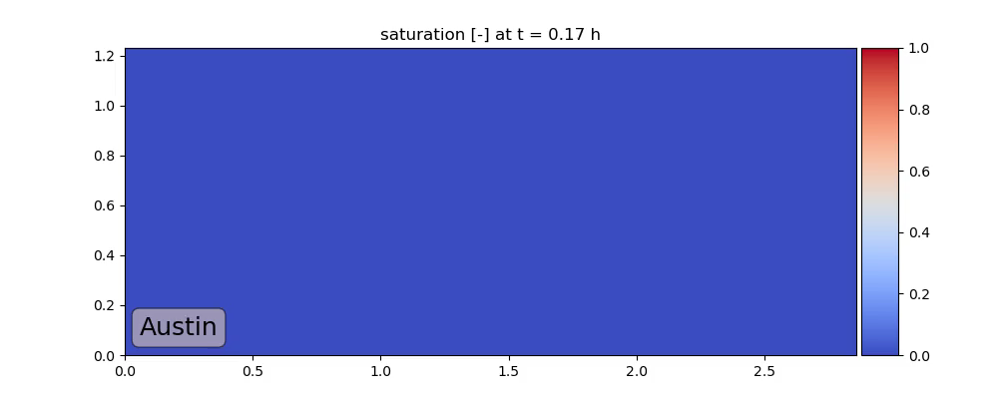
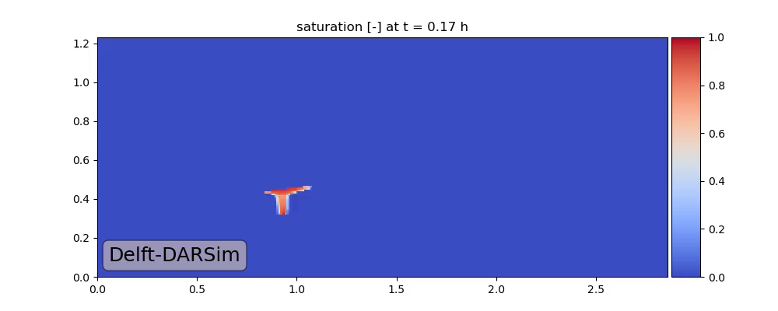
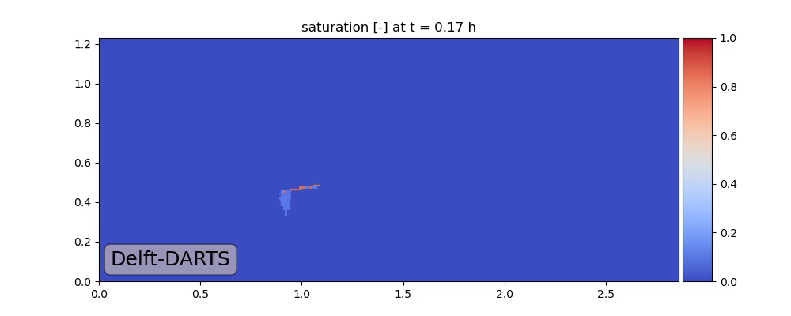
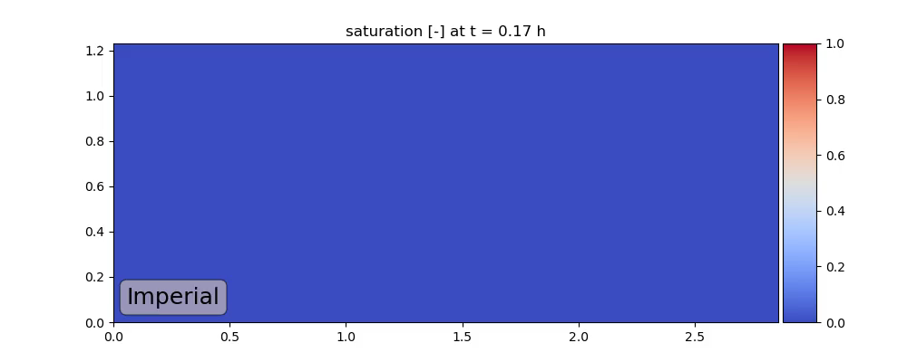

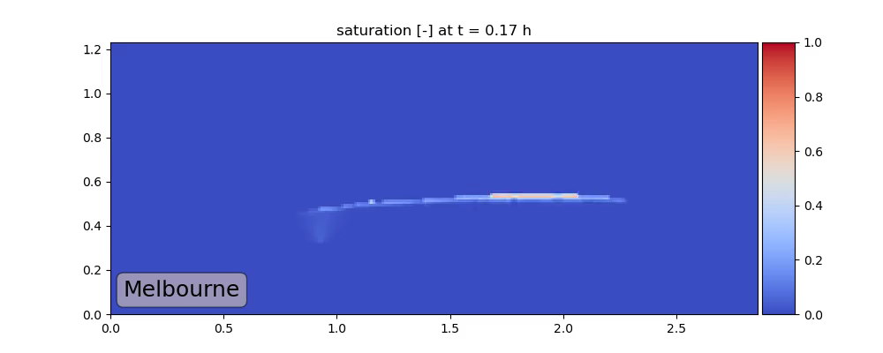
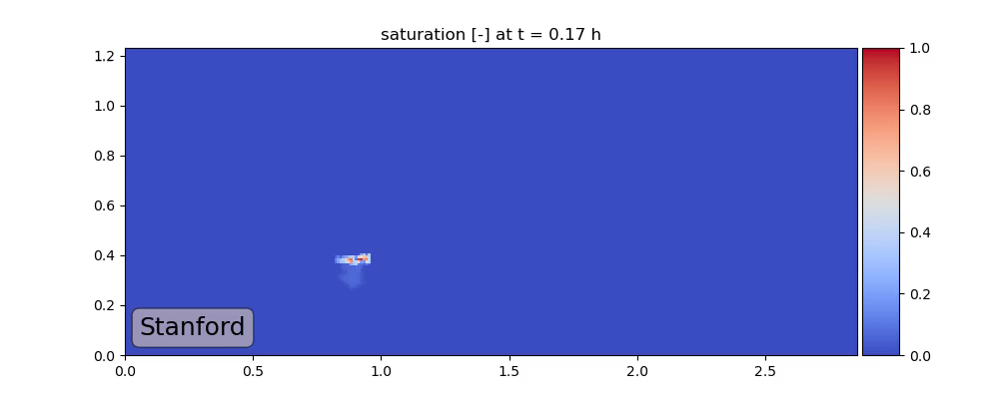
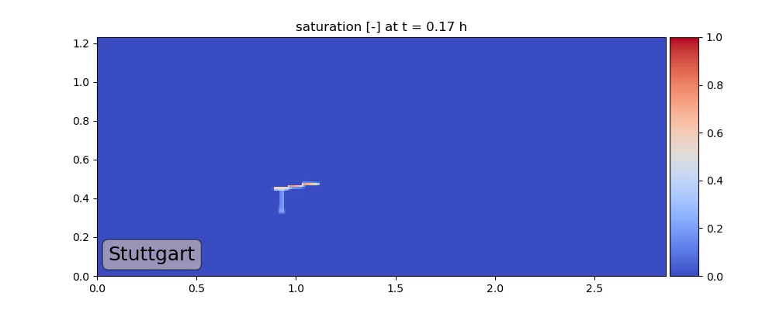
Spatial Maps First 24 Hours
Saturation

Slide 5
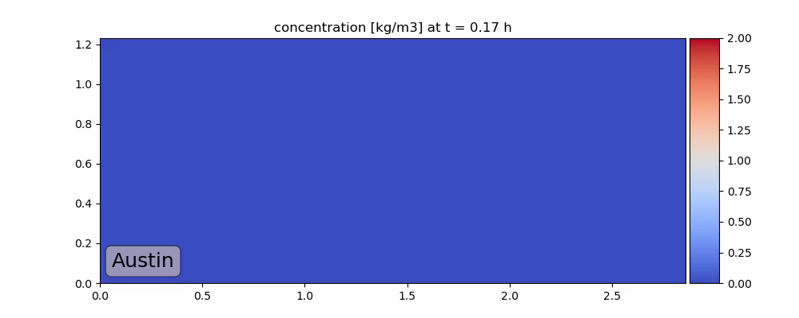
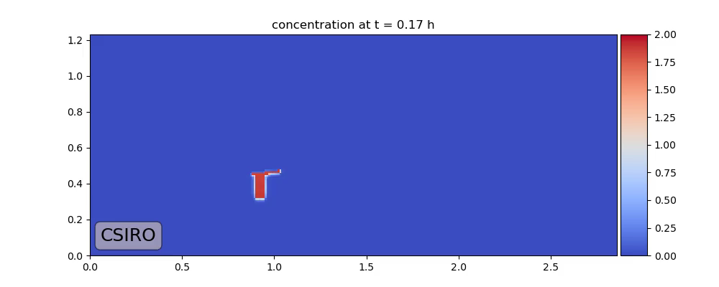
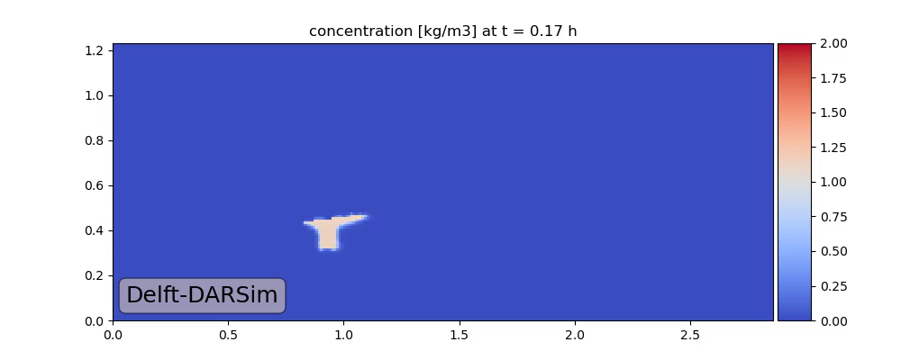
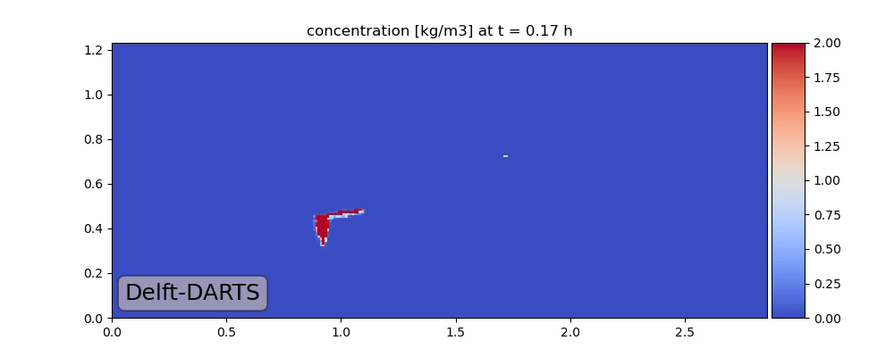

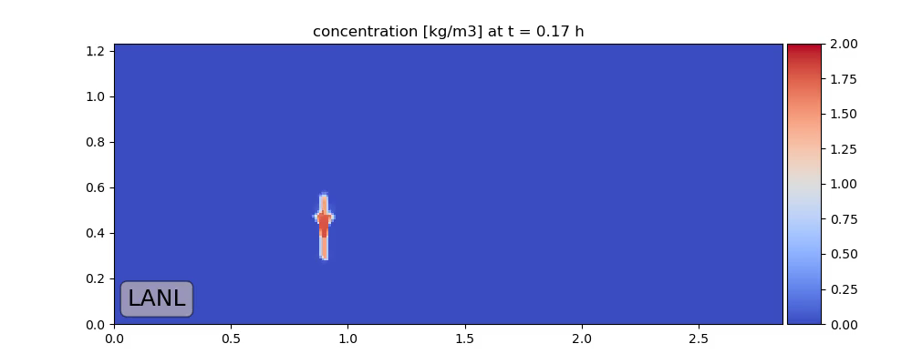
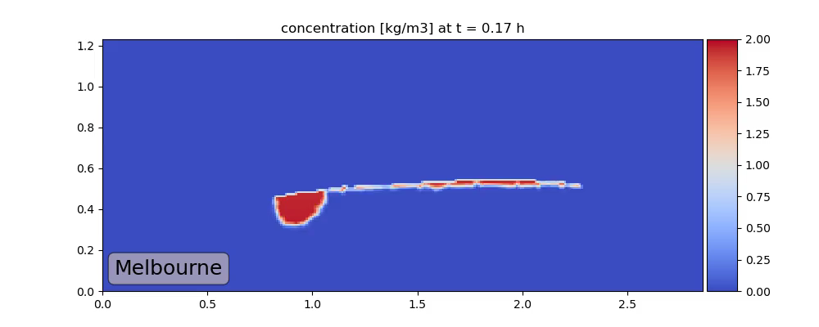
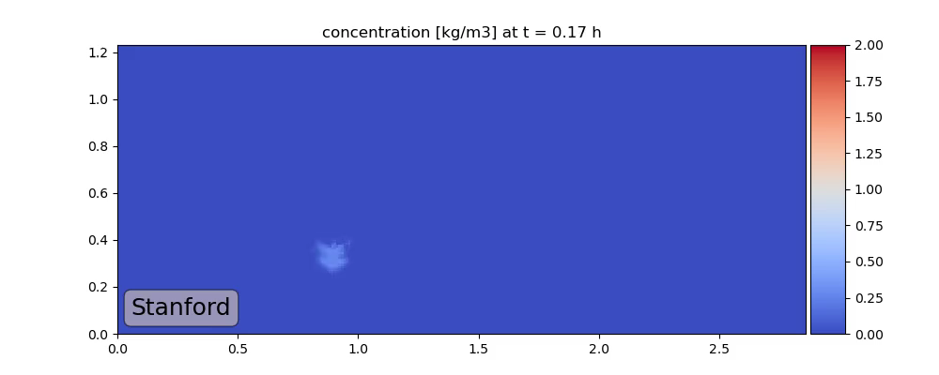
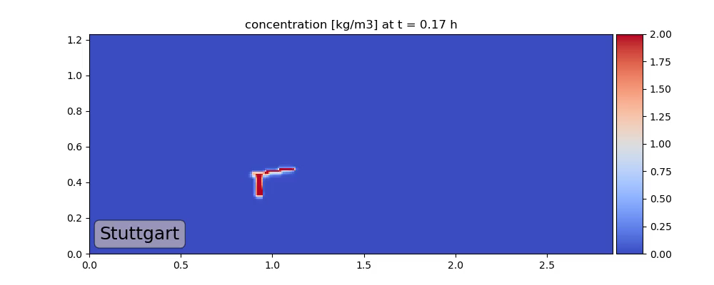
Spatial Maps First 24 Hours
Concentration

Slide 6
Spatial Maps First 24 Hours
Austin

Slide 7
Spatial Maps First 24 Hours
CSIRO

Slide 8
Spatial Maps First 24 Hours
Delft-DARSim

Slide 9
Spatial Maps First 24 Hours
Delft-DARTS

Slide 10
Spatial Maps First 24 Hours
Imperial

Slide 11
Spatial Maps First 24 Hours
LANL

Slide 12
Spatial Maps First 24 Hours
Melbourne

Slide 13
Spatial Maps First 24 Hours
Stanford Low Dissolution

Slide 14
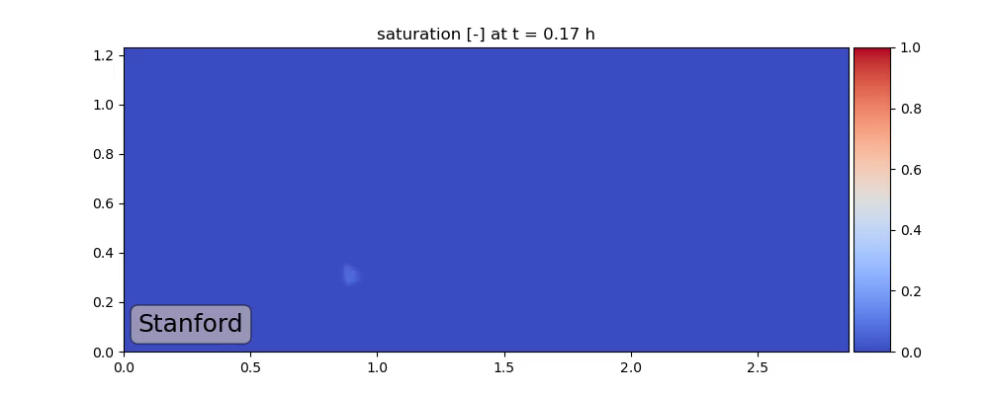
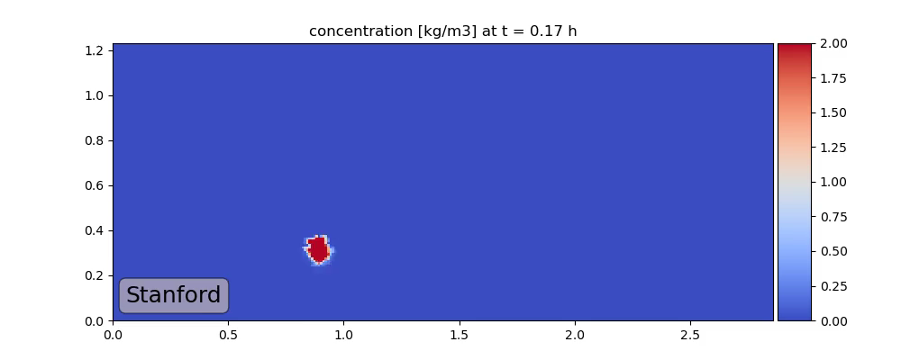
Spatial Maps First 24 Hours
Stanford High Dissolution

Slide 15
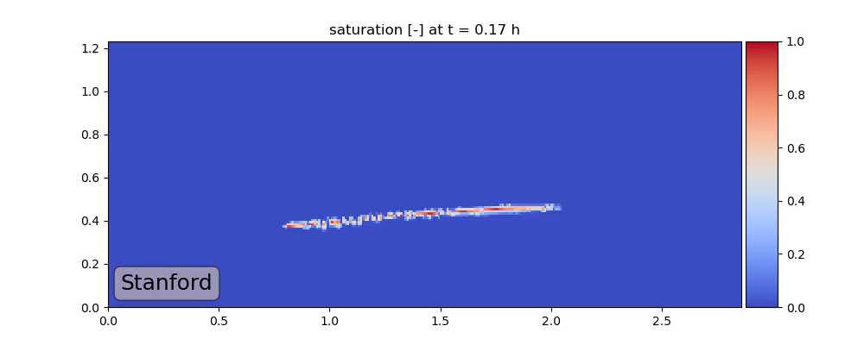

Spatial Maps First 24 Hours
Standford Only pc

Slide 16
Spatial Maps First 24 Hours
Stuttgart

Slide 17
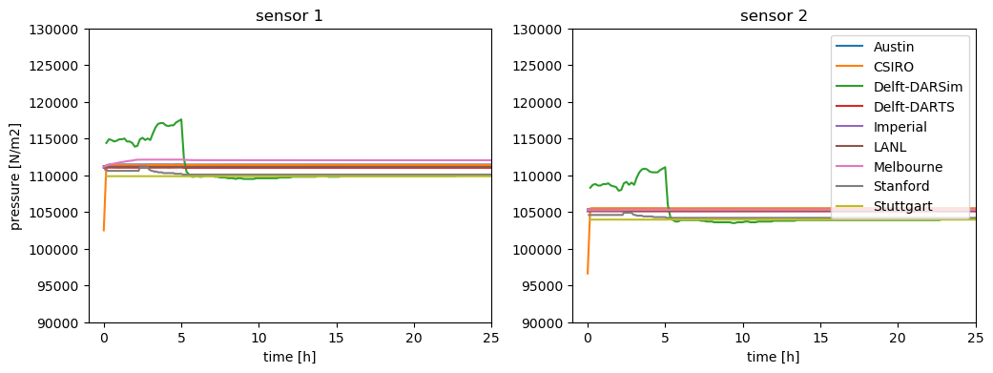
Time Series: Pressure

Slide 18
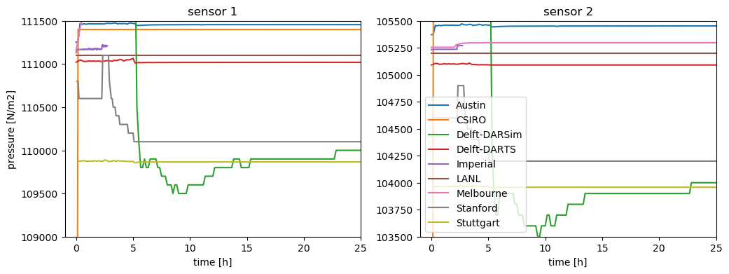
Time Series: Pressure Zoom into Values

Slide 19
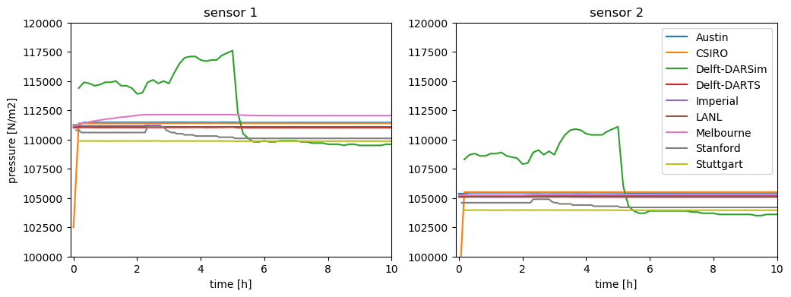
Time Series: Pressure Zoom into Time

Slide 20
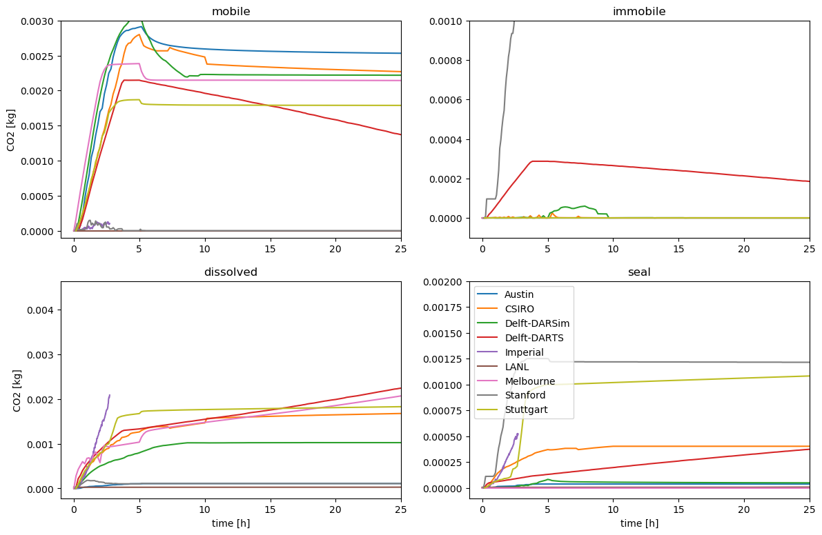
Time Series: Box A

Slide 21
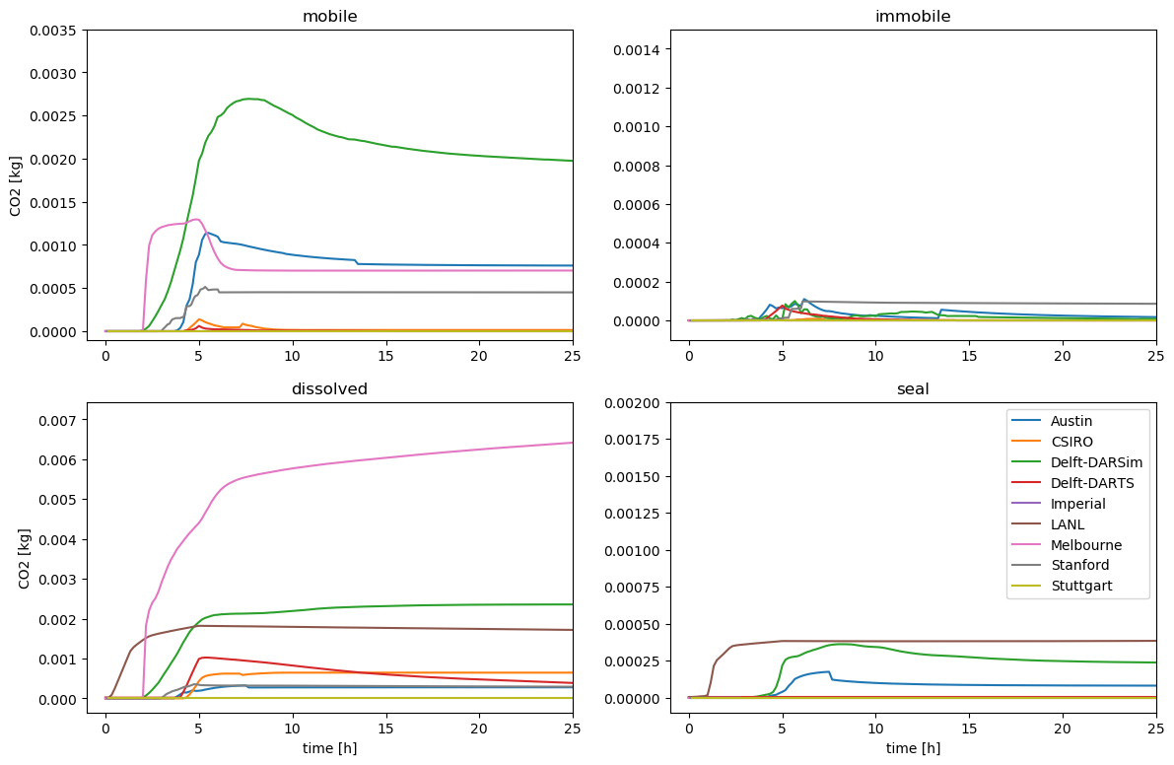
Time Series: Box B

Slide 22
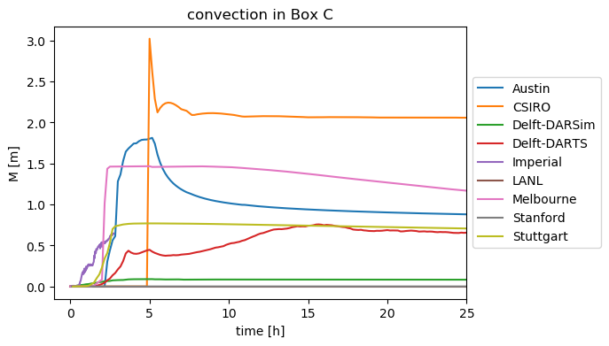
Time Series: Box C

Slide 23
Modeling Choices
Type | Austin | CSIRO | Delft-DARTS | Imperial | LANL | Melbourne | Stanford | Stuttgart
PDEs | CMB | CMB | CMB | PMB + CO2-dissolved transport | CMB | PMB + CO2-dissolved transport | Pseudo Black Oil | CMB
pc, relperm | BC | BC | const. pEntry, power law | const. pEntry, power law | Linear | BC | BC pc, linear + quad. relperm | BC
EOS | PR | Spycher fugacity-based | constant K-values | n/a | Duan & Sun |  | Weiss, Sandve et al., Duan & Sun | Spycher & Pruess, Duan & Sun, Spycher, Pruess & Ennis-King
density |  | IAPWS + Garcia, Span & Wagner | (1002 + x_CO2 * 320) * (1 + 1e-6 * (p - 1)), 2 * (1 + 1e-4 * (p - 1)) |  | Span & Wagner |  | Phillips et al., Fenghour & Wakeham, Span & Wagner | IAPWS, Span & Wagner
Coupling | FC, FI, vel.-enhanced MFEM | FC, FI, cell-centered FV | FC, FI, cell-centered FV | FC, FI, double CV FEM | FC, FI, cell-centered FV |  | FI, cell-centered FV | FC, FI, cell-centered FV
Solvers | GMRES-AMG | Newton-LS, GMRES-ASM | Newton-Chop, GMRES-CPR | Anderson, GMRES-HYPRE | Newton, FGMRES-CPR |  | Direct linear | Newton-LS, direct linear

Slide 24
Spatial Parameters: Permeability [m²]
Facies | Description | New Meas-urements | Austin | CSIRO | Delft-DARTS | LANL | Stuttgart
G | 4.82e-10 | 9.45e-09 | 1.10e-09 | 1.34e-09 | 5.60e-10 | 4.88e-10 | 1.00e-09
F | 2.55e-10 | 4.20e-09 | 8.50e-10 | 1.08e-09 | 1.48e-09 | 2.58e-10 | 9.00e-10
E | 6.99e-10 | 1.98e-09 | 7-08e-10 | 6.78e-10 | 8.59e-10 | 7.08e-10 | 7.08e-10
D | 4.18e-10 | 1.10e-09 | 4.24e-10 | 3.10e-10 | 5.46e-10 | 4.24e-10 | 4.24e-10
C | 2.89e-10 | 4.67e-10 | 2.39e-10 | 1.44e-10 | 4.39e-10 | 2.93e-10 | 2.93e-10
ESF | 3.85e-11 | 4.34e-11 | 3.90e-11 | 2.62e-11 | 3.85e-11 | 3.90e-12 | 3.90e-11
Barrier |  |  | 1.00e-18 | 0.00e-00 |  | 1.00e-15 | 1.00e-16

Slide 25
Spatial Parameters: Porosity [-]
Facies | Description | New Meas-urements | Austin | CSIRO | Delft-DARTS | LANL | Stuttgart
G | 0.46 | 0.44 | 0.46 | 0.46 | 0.46 | 0.46 | 0.46
F | 0.43 | 0.45 | 0.43 | 0.43 | 0.43 | 0.43 | 0.43
E | 0.45 | 0.45 | 0.45 | 0.45 | 0.45 | 0.45 | 0.45
D | 0.44 | 0.44 | 0.44 | 0.44 | 0.44 | 0.44 | 0.44
C | 0.43 | 0.44 | 0.43 | 0.43 | 0.43 | 0.43 | 0.43
ESF | 0.44 | 0.43 | 0.44 | 0.44 | 0.44 | 0.44 | 0.44
Barrier |  |  | 0.01 | 0.1 |  | 0.1 | 0.1

Slide 26
Spatial Parameters: S_lr
Facies | Description | New Meas-urements | Austin | CSIRO | Delft-DARTS | LANL | Stuttgart
G | 0.14 | 0.10 | 0.14 | 0.14 |  | 0.00 | 0.14
F | 0.03 | 0.12 | 0.03 | 0.03 |  | 0.00 | 0.03
E | 0.21 | 0.12 | 0.21 | 0.21 |  | 0.00 | 0.21
D | 0.17 | 0.12 | 0.17 | 0.17 |  | 0.00 | 0.17
C | 0.15 | 0.14 | 0.15 | 0.15 |  | 0.00 | 0.15
ESF |  | 0.32 | 0.15 | 0.05 |  | 0.00 | 0.2
Barrier |  |  | 0.00 | 0.05 |  | 0.00 | 0.1

Slide 27
Spatial Parameters: S_gr
Facies | Description | New Meas-urements | Austin | CSIRO | Delft-DARTS | LANL | Stuttgart
G |  | 0.06 | 0.1 | 0.1 |  | 0.1 | 0.1
F |  | 0.13 | 0.1 | 0.0 |  | 0.0 | 0.1
E |  | 0.06 | 0.1 | 0.0 |  | 0.0 | 0.1
D |  | 0.08 | 0.1 | 0.0 |  | 0.0 | 0.1
C |  | 0.10 | 0.1 | 0.0 |  | 0.0 | 0.1
ESF |  | 0.14 | 0.1 | 0.0 |  | 0.0 | 0.1
Barrier |  |  | 0.0 | 0.0 |  | 0.0 | 0.1

Slide 28
Spatial Parameters: pEntry [N/m²]
Facies | Description | New Meas-urements | Austin | CSIRO | Delft-DARTS | LANL | Stuttgart
G |  |  | 0 | 0 |  | 0 | 10.0
F |  |  | 0 | 0 |  | 0 | 10.0
E |  |  | 0 | 0 |  | 0 | 10.0
D | 98.1 |  | 98.1 | 98.1 |  | 98.1 | 98.1
C | 294.3 |  | 294.3 | 294.3 |  | 294.3 | 294.3
ESF | 1471.5 |  | 1471.5 | 1471.5 |  | 1471.5 | 1471.5
Barrier |  |  | 0 | 0 |  | 0 | 10.0

Slide 29
Spatial Parameters: kr_l, end
Facies | Description | New Meas-urements | Austin | CSIRO | Delft-DARTS | LANL | Stuttgart
G | 0.72 | 0.75 | 0.72 | 0.72 | 0.75 | 0.72 | 0.72
F |  | 0.72 | 0.72 | 1.00 | 0.75 | 1.00 | 0.72
E |  | 0.93 | 0.72 | 1.00 | 0.75 | 1.00 | 0.72
D |  | 0.95 | 0.72 | 1.00 | 0.75 | 1.00 | 0.72
C |  | 0.93 | 0.72 | 1.00 | 0.8 | 1.00 | 0.72
ESF |  | 0.71 | 0.72 | 1.00 | 0.85 | 1.00 | 0.72
Barrier |  |  | 1.00 | 1.00 |  | 1.00 | 0.72

Slide 30
Spatial Parameters: kr_g, end
Facies | Description | New Meas-urements | Austin | CSIRO | Delft-DARTS | LANL | Stuttgart
G | 0.10 |  | 0.16 | 0.16 |  | 0.16 | 0.16
F |  |  | 0.11 | 0.11 |  | 0.11 | 0.11
E |  |  | 0.10 | 0.10 |  | 0.10 | 0.10
D |  | 0.02 | 0.20 | 0.20 |  | 0.20 | 0.20
C |  | 0.05 | 0.20 | 0.20 |  | 0.20 | 0.20
ESF |  | 0.09 | 0.20 | 1.00 |  | 1.00 | 0.20
Barrier |  |  | 1.00 | 1.00 |  | 1.00 | 0.20

Slide 31
What‘s next? I
Poll for final workshop: https://terminplaner4.dfn.de/IzJYBq7IJhi4JTWI
Double-check:
Total CO2 mass
Concentration values (particularly Austin and Stanford)
Numbers to report:
Temperature
Dissolution limit at the tank bottom
Total volume of the domain
Solver performance (time step sizes, #iterations/time step, …)
Mesh size, #dofs
Tracer tests:
Spatial maps for tracer concentration
Better match with assuming anisotropy?

Slide 32
What‘s next? II
Questions to experimenters:
CO2 relperms seem unrealistically low
ambient conditions
capillary pressure curves
Actual viscosity of water in the tank
density of solution at maximum CO2 dissolved

Slide 33
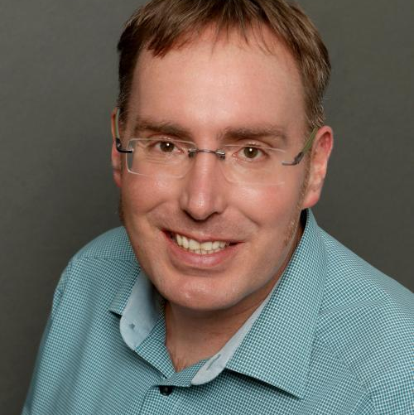
Institut für Wasser- und Umweltsystemmodellierung Lehrstuhl für Hydromechanik und Hydrosystemmodellierung
Bernd Flemisch
E-Mail
bernd@iws.uni-stuttgart.de
Telefon +49 (0) 711 685-
69162
www.
iws.uni-stuttgart.de/lh2
Universität Stuttgart
IWS-LH2
Pfaffenwaldring 61, 70569 Stuttgart

